Slide 1


Master of Computer Applications
(MCA Sem : 1)
(05MC0101) (Data structure using C)

Slide 2
UNIT – 5
Searching & Sorting

Slide 3
Searching
Searching means to find whether a particular value is present in an array or not.
If the value is present in the array, then searching is said to be successful and the searching process gives the location of that value in the array.
However, if the value is not present in the array, the searching process displays an appropriate message and in this case searching is said to be unsuccessful.

Slide 4
Searching
There are two popular methods for searching the array elements: linear search and binary search.

Slide 5
Linear Search
Linear search, also called as sequential search, is a very simple method used for searching an array for a particular value.
It works by comparing the value to be searched with every element of the array one by one in a sequence until a match is found.
Linear search is mostly used to search an unordered list of elements (array in which data elements are not sorted). For example, if an array
A[] is declared and initialized as,
int A[] = {10, 8, 2, 7, 3, 4, 9, 1, 6, 5};

Slide 6
Linear Search
the value to be searched is VAL = 7, then searching means to find whether the value ‘7’ is present in the array or not.
If yes, then it returns the position of its occurrence. Here,
POS = 3 (index starting from 0).

Slide 7
Linear Search
#include<stdio.h>
#include<conio.h>
void main()
{
int a[20],i,x,n;
clrscr();
printf("How many elements?");
scanf("%d",&n);
printf("Enter array elements:\n");
for(i=0;i<n;++i)
{
scanf("%d",&a[i]);
}
printf("\nEnter element to search:");
scanf("%d",&x);

Slide 8
Linear Search
for(i=0;i<n;++i)
{
if(a[i]==x)
break;
}
if(i<n)
printf("Element found at index %d",i);
else
printf("Element not found");
getch();
}

Slide 9
Binary Search
Search a sorted array by repeatedly dividing the search interval in half is called Binary Search.
Binary search is a searching algorithm that works efficiently with a sorted list. The mechanism of binary search can be better understood by an analogy of a telephone directory.
When we are searching for a particular name in a directory, we first open the directory from the middle and then decide whether to look for the name in the first part of the directory or in the second part of the directory.
Again, we open some page in the middle and the whole process is repeated until we finally find the right name

Slide 10
Binary Search
Now, let us consider how this mechanism is applied to search for a value in a sorted array.
Consider an array A[] that is declared and initialized as int A[] = {0, 1, 2, 3, 4, 5, 6, 7, 8, 9, 10};
and the value to be searched is VAL = 9. The algorithm will proceed in the following manner.
BEG = 0, END = 10, MID = (0 + 10)/2 = 5
Now, VAL = 9 and A[MID] = A[5] = 5
A[5] is less than VAL, therefore, we now search for the value in the second half of the array. So, we change the values of BEG and MID.

Slide 11
Binary Search
Now, BEG = MID + 1 = 6, END = 10, MID = (6 + 10)/2 =16/2 = 8
VAL = 9 and A[MID] = A[8] = 8
A[8] is less than VAL, therefore, we now search for the value in the second half of the segment.
So, again we change the values of BEG and MID.
Now, BEG = MID + 1 = 9, END = 10, MID = (9 + 10)/2 = 9
Now, VAL = 9 and A[MID] = 9.

Slide 12
Binary Search
#include<stdio.h>
#include<conio.h>
void main()
{
int c, first, last, middle, n, search, array[100];
printf("Enter number of elements\n");
scanf("%d", &n);
printf("Enter %d integers\n", n);
for (c = 0; c < n; c++)
scanf("%d", &array[c]);
printf("Enter value to find\n");
scanf("%d", &search);
first = 0;
last = n - 1;
middle = (first+last)/2;

Slide 13
Binary Search
while (first <= last)
{
if (array[middle] < search)
{
first = middle + 1;
}
else if (array[middle] == search)
{
printf("%d found at location %d.\n", search, middle+1);
break;
}
else
{
last = middle - 1;
}
middle = (first + last)/2;
}
if (first > last)
printf("Not found! %d isn't present in the list.\n", search);
getch();
}

Slide 14
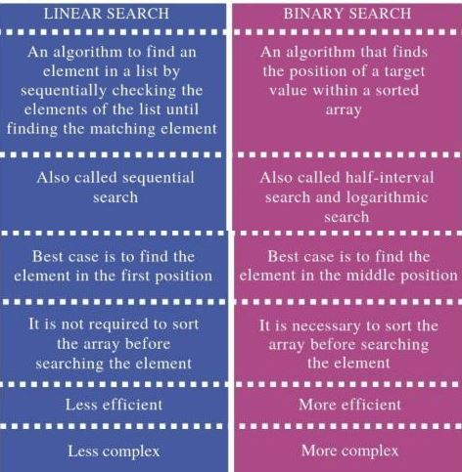
Difference Between Linear Search and Binary Search

Slide 15
Hashing
Hashing is a fundamental concept in computer science used for efficient data storage and retrieval. It involves mapping data of arbitrary size to fixed-size values, typically integers, known as hash codes or hash values. The primary purpose of hashing is to quickly locate a data record (or bucket) regardless of the size of the dataset.
In hashing, a hash function is used to generate the hash code from the input data. The hash function takes the input data and produces a fixed-size hash code as output. This hash code is used as an index or key to store or retrieve the data in a data structure called a hash table.

Slide 16
Hashing
Hashing offers several advantages:
Fast Access: Hashing allows for constant-time access to data in the best-case scenario, making it highly efficient for storing and retrieving information.
Dynamic Data Size: Hashing can handle datasets of varying sizes efficiently, as the size of the hash table can dynamically adjust based on the number of elements stored.
Collision Handling: Hashing provides mechanisms for handling collisions, which occur when two different data elements produce the same hash code. Techniques such as chaining or open addressing can resolve collisions efficiently.
Common applications of hashing include:

Slide 17
Hashing
Data Storage: Hashing is used in databases and file systems to store and retrieve records quickly.
Data Retrieval: Hashing is used in data structures such as hash tables, hash maps, and hash sets for fast lookup operations.
Password Storage: Hashing is used to store passwords securely by converting them into hash codes, making it difficult for attackers to reverse-engineer the original passwords.
Overall, hashing is a powerful technique used extensively in computer science and software engineering for efficient data storage, retrieval, and security purposes.

Slide 18
Hashing
A hash function is a mathematical function that takes an input (or "key") and returns a fixed-size string of bytes, which typically represents a hash code or hash value. The output generated by a hash function is commonly used to index data in hash tables, for cryptographic applications, or for data integrity verification.
A good hash function should have the following properties:
Deterministic: For the same input, a hash function should always produce the same output.
Fast: The computation of the hash value should be efficient and quick.
Uniform Distribution: The hash values should be uniformly distributed across the range of possible hash codes, reducing the likelihood of collisions.

Slide 19
Hashing
Minimal Collisions: A collision occurs when two different inputs produce the same hash value. A good hash function should minimize the number of collisions.
Avalanche Effect: A small change in the input should result in a significantly different hash value.

Slide 20
Collision Resolution Techniques
Collision resolution techniques are methods used to handle collisions that occur when two different keys hash to the same index in a hash table. There are several collision resolution techniques, two of the most common ones being open addressing and chaining.
Open Addressing:
In open addressing, also known as closed hashing, when a collision occurs, the algorithm probes the table for another empty slot to place the collided element.
There are several strategies for probing:
Linear Probing: In linear probing, if a collision occurs at index i, the algorithm checks the next index (i+1) and continues linearly until an empty slot is found. It wraps around to the beginning of the table if necessary.
Quadratic Probing: In quadratic probing, the algorithm probes slots by adding increasing quadratic values to the original hash index until an empty slot is found.
Double Hashing: In double hashing, the algorithm uses a second hash function to determine the step size for probing. It calculates the step size as the hash of the key modulo a prime number, ensuring that the step size is relatively prime to the table size.
Open addressing techniques typically require a load factor threshold to ensure efficient performance. If the load factor exceeds a certain threshold, the hash table needs to be resized to maintain a low collision rate.
Chaining:

Slide 21
Collision Resolution Techniques
In chaining, each slot in the hash table contains a linked list of elements that hash to the same index. When a collision occurs, the collided element is inserted into the linked list at the corresponding index.
Chaining is flexible and can handle any number of collisions without affecting the performance of other elements in the table.
However, chaining may incur additional memory overhead due to the storage of linked lists.
Each collision resolution technique has its advantages and disadvantages:

Slide 22
Collision Resolution Techniques
Open Addressing:
Advantages: Simple implementation, space-efficient (no additional memory overhead for pointers), cache-friendly.
Disadvantages: Increased likelihood of clustering, more sensitive to hash function quality, and requires careful handling of deletions.
Chaining:
Advantages: Can handle any number of collisions, unaffected by the quality of the hash function, easy to implement.
Disadvantages: Requires additional memory for pointers, cache-unfriendly due to pointer traversal, and less space-efficient than open addressing for small data.
The choice between open addressing and chaining depends on factors such as the expected number of elements, memory constraints, and performance requirements of the specific application.

Slide 23
Collision Resolution Techniques
#include <stdio.h>
#define TABLE_SIZE 10
int hashFunction(int key) {
return key % TABLE_SIZE;
}
void insert(int hashTable[], int key) {
int index = hashFunction(key);
while (hashTable[index] != -1) {
index = (index + 1) % TABLE_SIZE;
}
hashTable[index] = key;
}
void display(int hashTable[]) {
for (int i = 0; i < TABLE_SIZE; i++) {
if (hashTable[i] != -1) {
printf("Index %d: %d\n", i, hashTable[i]);
} else {
printf("Index %d: Empty\n", i);
}
}
}

Slide 24
Collision Resolution Techniques
int main() {
int hashTable[TABLE_SIZE];
for (int i = 0; i < TABLE_SIZE; i++) {
hashTable[i] = -1;
}
int keys[] = {23, 43, 13, 27, 56, 72, 91};
int n = sizeof(keys) / sizeof(keys[0]);
for (int i = 0; i < n; i++) {
insert(hashTable, keys[i]);
}
display(hashTable);
return 0;
}

Slide 25
SORTING
Sorting means arranging the elements of an array so that they are placed in some relevant order which may be either ascending or descending.
For example, if we have an array that is declared and initialized as
int A[] = {21, 34, 11, 9, 1, 0, 22};
Then the sorted array (ascending order) can be given as:
A[] = {0, 1, 9, 11, 21, 22, 34};

Slide 26
BUBBLE SORT
Bubble sort is a very simple method that sorts the array elements by repeatedly moving the largest element to the highest index position of the array segment (in case of arranging elements in ascending order).
In bubble sorting, consecutive adjacent pairs of elements in the array are compared with each other. If the element at the lower index is greater than the element at the higher index, the two elements are interchanged so that the element is placed before the bigger one.
This process will continue till the list of unsorted elements exhausts.

Slide 27
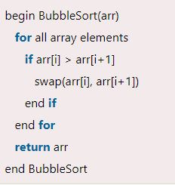
BUBBLE SORT
Algorithm

Slide 28
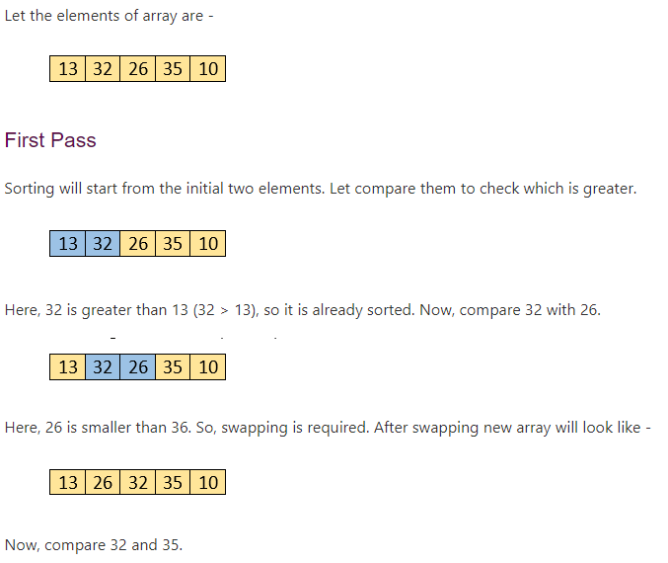
BUBBLE SORT

Slide 29
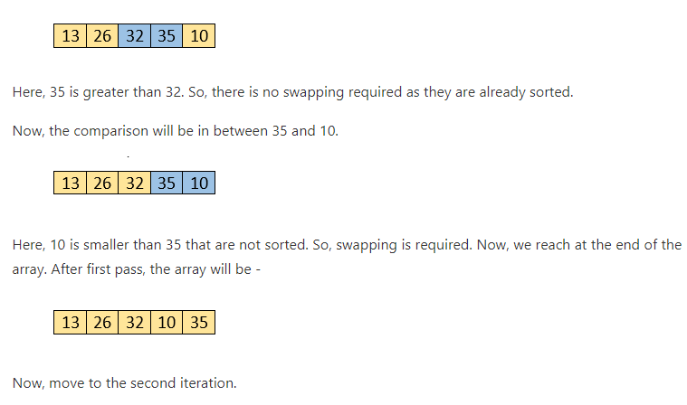
BUBBLE SORT

Slide 30

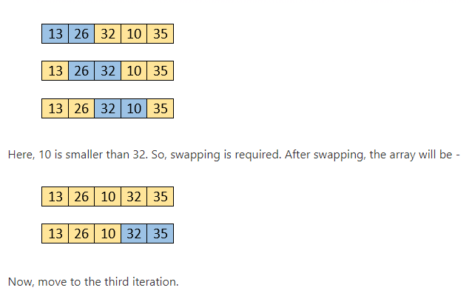
BUBBLE SORT

Slide 31

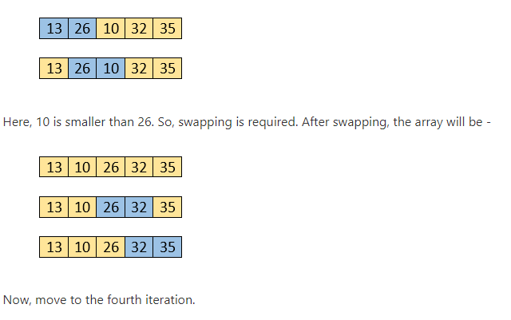
BUBBLE SORT

Slide 32
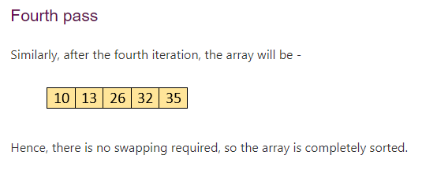
BUBBLE SORT

Slide 33
BUBBLE SORT
#include<stdio.h>
#include<conio.h>
void main()
{
int array[100], n,i,j, swap;
clrscr();
printf("Enter number of elements\n");
scanf("%d", &n);
printf("Enter %d integers\n", n);
for (i = 0; i < n; i++)
{
scanf("%d", &array[i]);
}

Slide 34
BUBBLE SORT
for (i = 0 ; i < n - 1; i++)
{
for (j = 0 ; j < n - i - 1; j++)
{
if (array[j] > array[j+1])
{
swap = array[j];
array[j] = array[j+1];
array[j+1] = swap;
}
}
}

Slide 35
BUBBLE SORT
printf("Sorted list in ascending order:\n");
for (i = 0; i < n; i++)
printf("%d\n", array[i]);
getch();
}

Slide 36
INSERTION SORT
Insertion Sort in C is a simple and efficient sorting algorithm, that creates the final sorted array one element at a time.
The main idea behind insertion sort is that it inserts each item into its proper place in the final list. To save memory, most implementations of the insertion sort algorithm work by moving the current data element past the already sorted values and repeatedly interchanging it with the preceding value until it is in its correct place. If the given input array is sorted or nearly sorted, then it gives best performance.

Slide 37
INSERTION SORT
Insertion sort works similar to the sorting of playing cards in hands. It is assumed that the first card is already sorted in the card game, and then we select an unsorted card. If the selected unsorted card is greater than the first card, it will be placed at the right side; otherwise, it will be placed at the left side. Similarly, all unsorted cards are taken and put in their exact place.

Slide 38
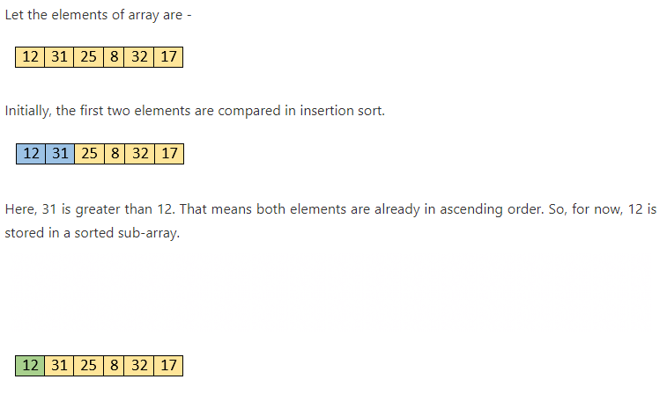
INSERTION SORT

Slide 39
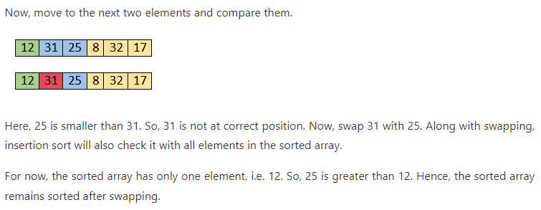
INSERTION SORT

Slide 40
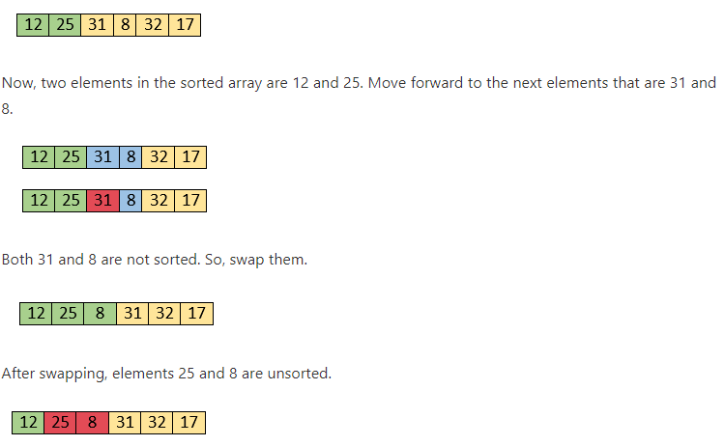
INSERTION SORT

Slide 41
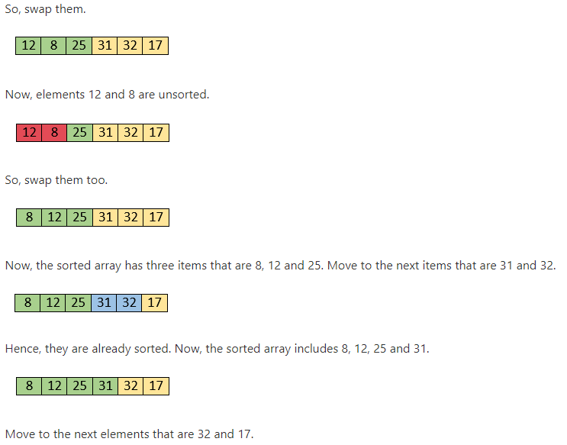
INSERTION SORT

Slide 42
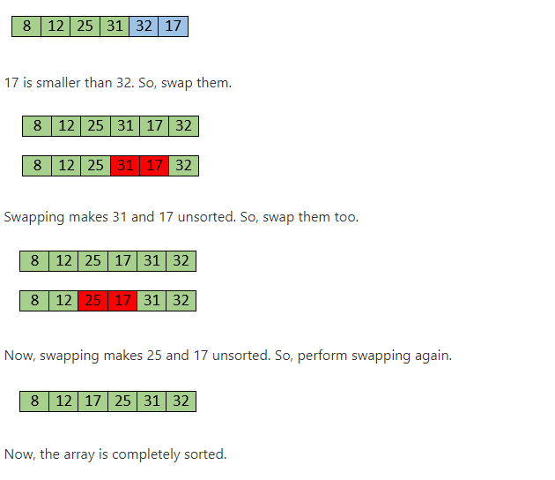
INSERTION SORT

Slide 43
INSERTION SORT
#include<stdio.h>
#include<conio.h>
void main()
{
int n, array[100], c, d, t, flag = 0;
clrscr();
printf("Enter number of elements\n");
scanf("%d", &n);
printf("Enter %d integers\n", n);
for (c = 0; c < n; c++)
scanf("%d", &array[c]);
for (c = 1 ; c <= n - 1; c++)
{
t = array[c];
for (d = c - 1 ; d >= 0; d--)
{

Slide 44
INSERTION SORT
if (array[d] > t)
{
array[d+1] = array[d];
flag = 1;
}
else
break;
}
if (flag)
array[d+1] = t;
}
printf("Sorted list in ascending order:\n");
for (c = 0; c <= n - 1; c++)
{
printf("%d\n", array[c]);
}
getch();
}

Slide 45
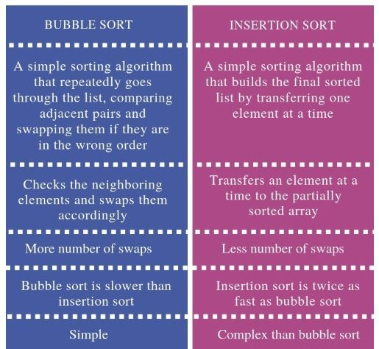
Differentiate Bubble Sort and Insertion Sort

Slide 46
SELECTION SORT
Selection Sort algorithm is an in-place comparison-based algorithm in which the list is divided into two parts, the sorted part at the left end and the unsorted part at the right end.
Although selection sort performs worse than insertion sort algorithm, it is noted for its simplicity and also has performance advantages over more complicated algorithms in certain situations. Selection sort is generally used for sorting files with very large objects (records) and small keys.

Slide 47
SELECTION SORT
Selection sort works as follows:
First find the smallest value in the array and place it in the first position. Then, find the second smallest value in the array and place it in the second position. Repeat this procedure until the entire array is sorted.
Selection sort is not a stable sorting algorithm.
Consider the situation in which assignment operation is very costly. so that the number of assignment operations is minimized in general.

Slide 48
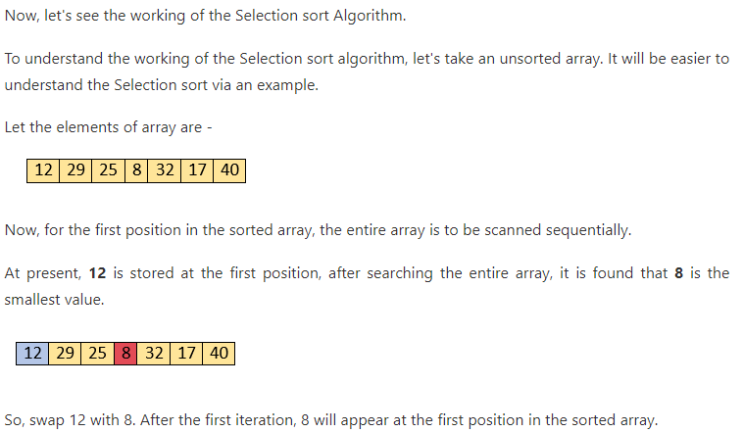
SELECTION SORT

Slide 49
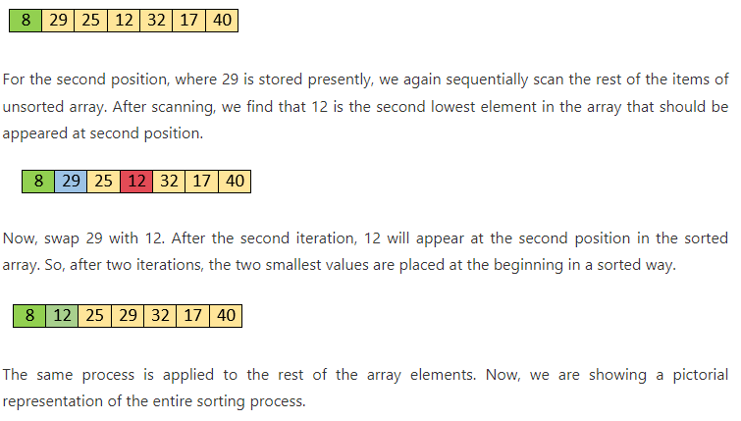
SELECTION SORT

Slide 50
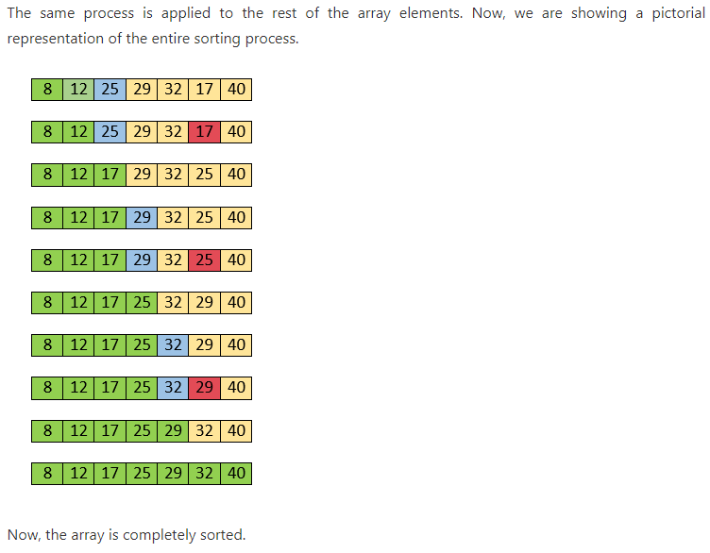
SELECTION SORT

Slide 51
SELECTION SORT
#include <stdio.h>
#include <conio.h>
void main()
{
int a[100], n, i, j, position, swap;
clrscr();
printf("Enter number of elements\n");
scanf("%d", &n);
printf("Enter %d Numbers\n", n);
for (i = 0; i < n; i++)
{
scanf("%d", &a[i]);
}
for(i = 0; i < n - 1; i++)
{
position=i;
for(j = i + 1; j < n; j++)
{
if(a[position] > a[j])
position=j;
}

Slide 52
SELECTION SORT
if(position != i)
{
swap=a[i];
a[i]=a[position];
a[position]=swap;
}
}
printf("Sorted Array:\n");
for(i = 0; i < n; i++)
{
printf("%d\n", a[i]);
}
getch();
}

Slide 53
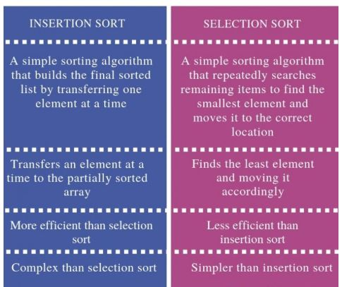
DIFFERENTIATE INSERTION AND SELECTION SORT

Slide 54
QUICK SORT
Quicksort is a divide and conquer algorithm.
The steps are: 1) Pick an element from the array, this element is called as pivot element. 2) Divide the unsorted array of elements in two arrays with values less than the pivot come in the first sub array, while all elements with values greater than the pivot come in the second sub-array (equal values can go either way). This step is called the partition operation. 3) Recursively repeat the step 2(until the sub-arrays are sorted) to the sub-array of elements with smaller values and separately to the sub-array of elements with greater values.
The same logic we have implemented in the following C program.

Slide 55
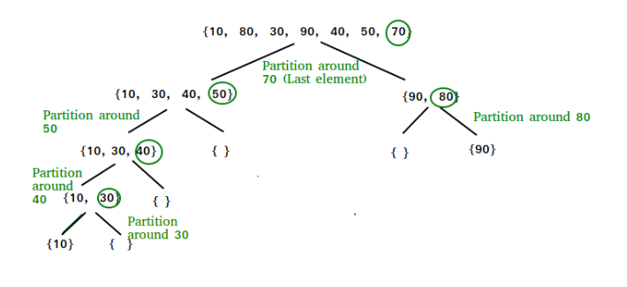
QUICK SORT

Slide 56
QUICK SORT
#include<stdio.h>
#include<conio.h>
void quicksort(int number[25],int first,int last)
{
int i, j, pivot, temp;
if(first<last)
{
pivot=last;
i=first;
j=last;
while(i<j)
{
while(number[i]<=number[pivot]&&i<last)
i++;
while(number[j]>number[pivot])
j--;
if(i<j)
{
temp=number[i];
number[i]=number[j];
number[j]=temp;
}
}

Slide 57
QUICK SORT
temp=number[pivot];
number[pivot]=number[j];
number[j]=temp;
quicksort(number,first,j-1);
quicksort(number,j+1,last);
}
}
void main()
{
int i, count, number[25];
clrscr();
printf("How many elements are u going to enter?: ");
scanf("%d",&count);
printf("Enter %d elements: ", count);
for(i=0;i<count;i++)
scanf("%d",&number[i]);
quicksort(number,0,count-1);
printf("Order of Sorted elements: ");
for(i=0;i<count;i++)
printf(" %d",number[i]);
getch();
}

Slide 58
HEAP SORT
Heap sort is a comparison based sorting technique based on Binary Heap data structure.
It is similar to selection sort where we first find the maximum element and place the maximum element at the end. We repeat the same process for remaining element.

Slide 59
HEAP SORT
Now, let's see the working of the Heapsort Algorithm.
In heap sort, basically, there are two phases involved in the sorting of elements. By using the heap sort algorithm, they are as follows –
The first step includes the creation of a heap by adjusting the elements of the array.
After the creation of heap, now remove the root element of the heap repeatedly by shifting it to the end of the array, and then store the heap structure with the remaining elements.

Slide 60
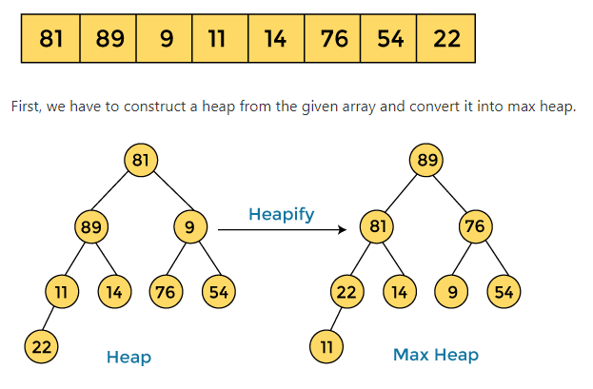
HEAP SORT

Slide 61
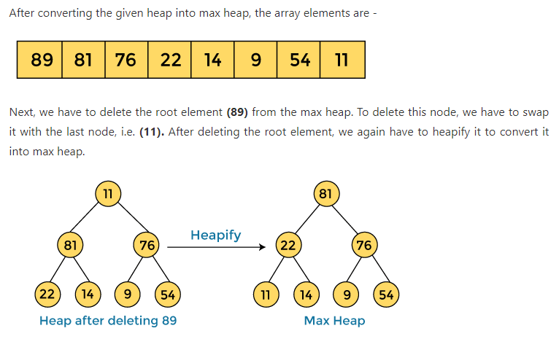
HEAP SORT

Slide 62
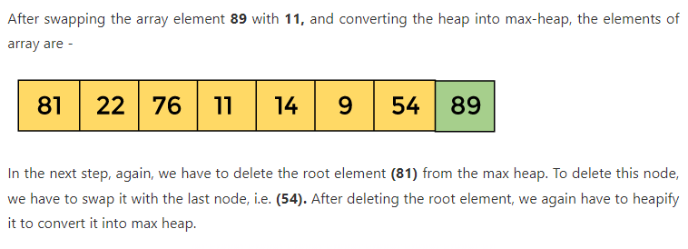
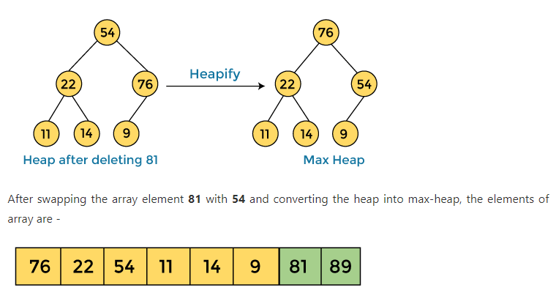
HEAP SORT

Slide 63
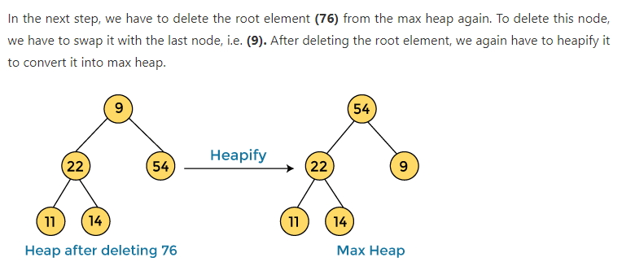
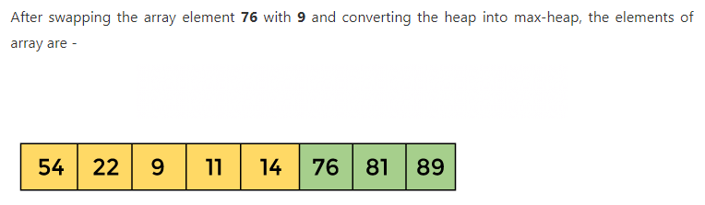
HEAP SORT

Slide 64
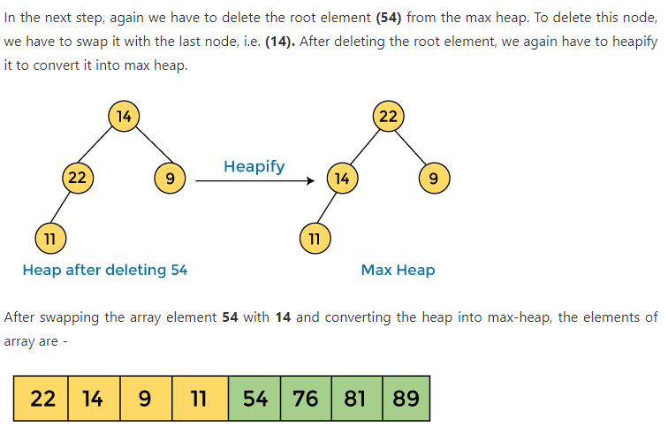
HEAP SORT

Slide 65
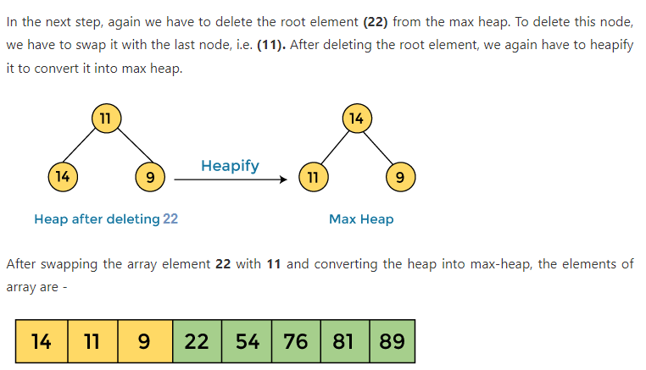
HEAP SORT

Slide 66
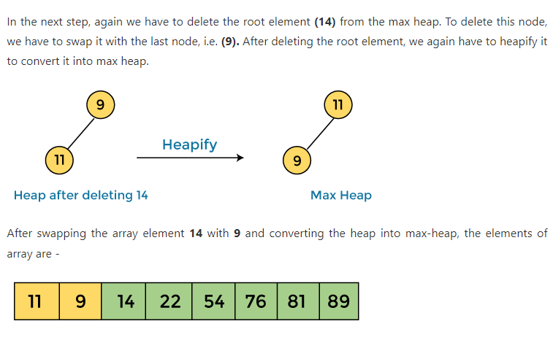
HEAP SORT

Slide 67
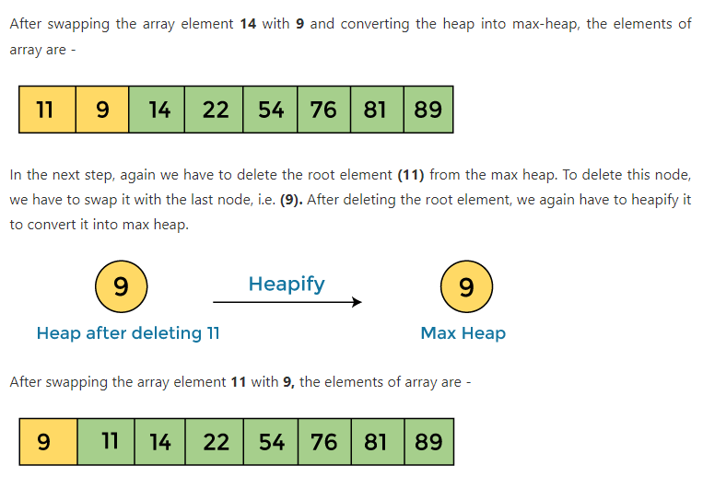
HEAP SORT

Slide 68
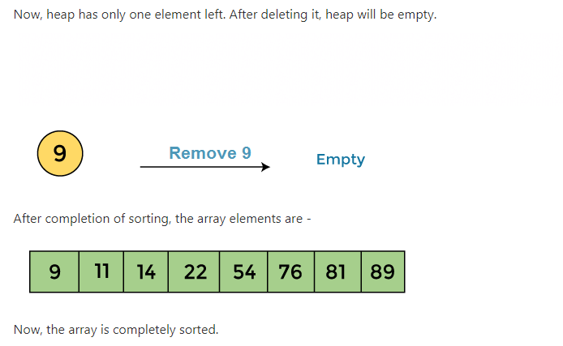
HEAP SORT

Slide 69
SHELL SORT
Shell sort is an algorithm that first sorts the elements far apart from each other and successively reduces the interval between the elements to be sorted. It is a generalized version of insertion sort.
In Shell sort, elements are sorted in multiple passes and in each pass, data are taken with smaller and smaller gap sizes. However, the last step of shell sort is a plain insertion sort.
But by the time we reach the last step, the elements are already ‘almost sorted’, and hence it provides good performance.

Slide 70
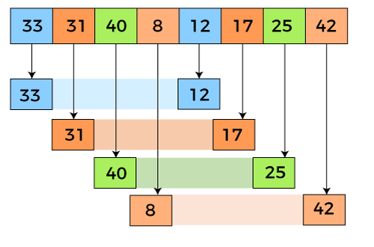
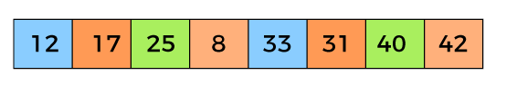
SHELL SORT

Slide 71
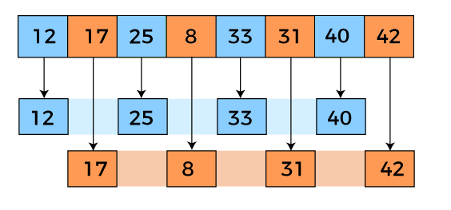
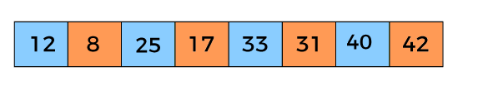
SHELL SORT

Slide 72
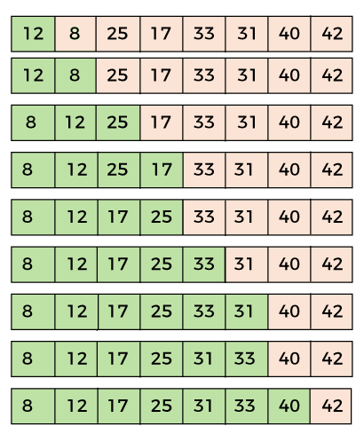
SHELL SORT

Slide 73
SHELL SORT
#include <stdio.h>
#include <conio.h>
void shellsort(int arr[], int num)
{
int i, j, k, tmp,gap;
for (gap = num / 2; gap > 0; gap = gap / 2)
{
for (j = gap; j < num; j++)
{
for(i = j - gap; i >= 0; i = i - gap)
{
if (arr[i+gap] >= arr[i])
break;
else
{
tmp = arr[i];
arr[i] = arr[i+gap];
arr[i+gap] = tmp;
}
}
}
}
}

Slide 74
SHELL SORT
void main()
{
int arr[30];
int k, num;
clrscr();
printf("Enter total no. of elements : ");
scanf("%d", &num);
printf("\nEnter %d numbers: ", num);
for (k = 0 ; k < num; k++)
{
scanf("%d", &arr[k]);
}
shellsort(arr, num);
printf("\n Sorted array is: ");
for (k = 0; k < num; k++)
printf("%d ", arr[k]);
getch();
}

Slide 75
RADIX SORT
Radix sort is a sorting technique that sorts the elements by first grouping the individual digits of same place value. Then, sort the elements according to their increasing/decreasing order.
A sorting algorithm is an algorithm that puts components of a listing in a certain order. The most-used orders are numerical order and lexicographic order.
The Radix sort is a non-comparative sorting algorithm. The Radix sort algorithm is the most preferred algorithm for the unsorted list.

Slide 76

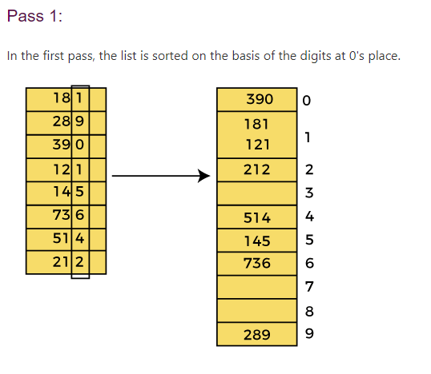
RADIX SORT

Slide 77
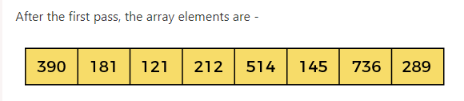
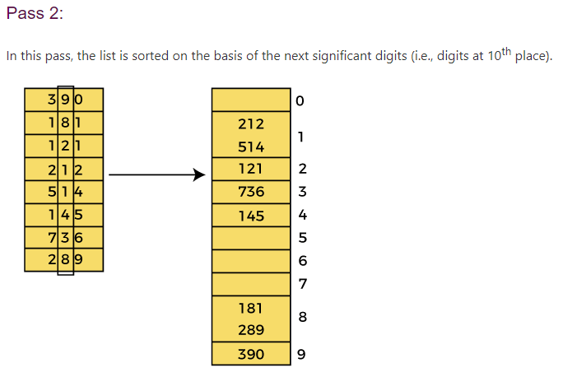
RADIX SORT

Slide 78
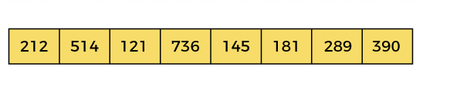
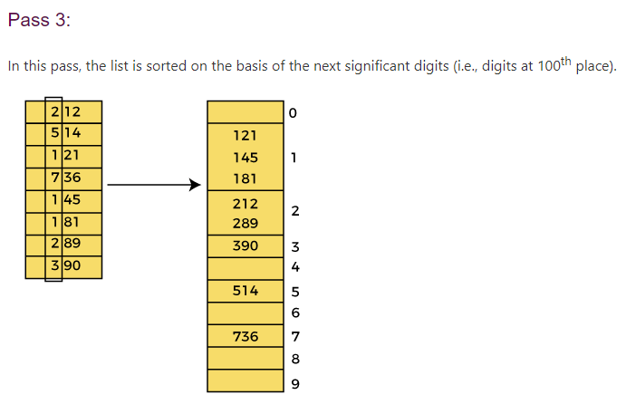
RADIX SORT

Slide 79
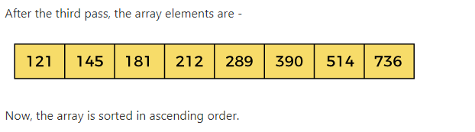
RADIX SORT

Slide 80
MERGE SORT
Merge Sort is a Divide and Conquer algorithm. It divides input array in two halves, calls itself for the two halves and then merges the two sorted halves.
It is very efficient sorting algorithm with near optimal number of comparison. Recursive Algorithm used for merge sort comes under the category of divide and conquer technique. It is stable sorting algorithm.
You can sort lots of amount of data using small available main memory using merge sort.
An array of n elements is split around its center producing two smaller arrays. After these two arrays are sorted independently, they can be merged to produce the final sorted array.

Slide 81

MERGE SORT
Working of Merge sort Algorithm
Now, let's see the working of merge sort Algorithm.
To understand the working of the merge sort algorithm, let's take an unsorted array. It will be easier to understand the merge sort via an example.
Let the elements of array are –
According to the merge sort, first divide the given array into two equal halves. Merge sort keeps dividing the list into equal parts until it cannot be further divided.
As there are eight elements in the given array, so it is divided into two arrays of size 4.

Slide 82
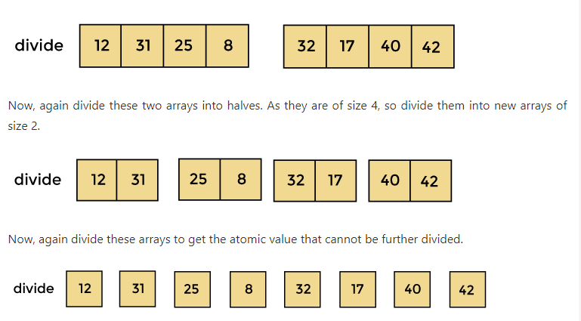
MERGE SORT

Slide 83
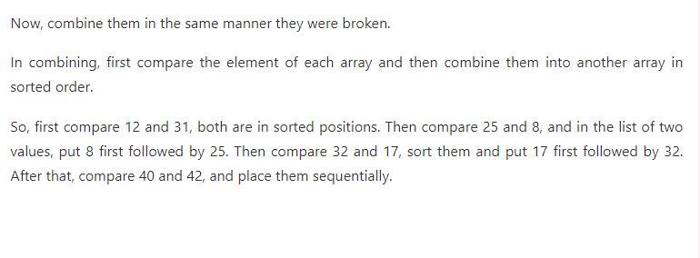
MERGE SORT

Slide 84
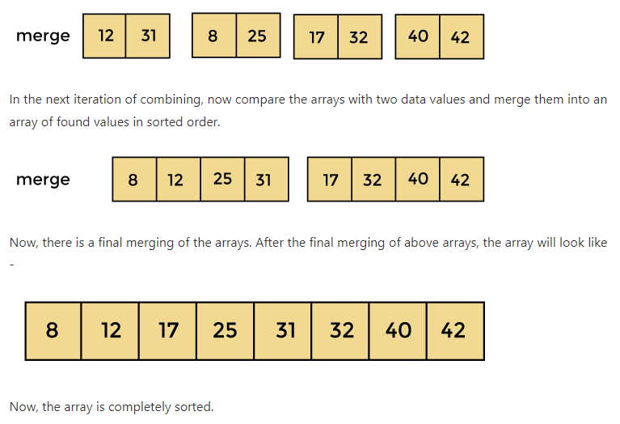
MERGE SORT

Slide 85
MERGE SORT
#include <stdio.h>
void merge(int arr[], int left, int mid, int right) {
int n1 = mid - left + 1;
int n2 = right - mid;
int L[n1], R[n2];
for (int i = 0; i < n1; i++)
L[i] = arr[left + i];
for (int i = 0; i < n2; i++)
R[i] = arr[mid + 1 + i];
int i = 0, j = 0, k = left;
while (i < n1 && j < n2) {
if (L[i] <= R[j]) {
arr[k] = L[i];
i++;
} else {
arr[k] = R[j];
j++;
}
k++;
}

Slide 86
MERGE SORT
while (i < n1) {
arr[k] = L[i];
i++;
k++;
}
while (j < n2) {
arr[k] = R[j];
j++;
k++;
}
}
void mergeSort(int arr[], int left, int right) {
if (left < right) {
int mid = left + (right - left) / 2;
mergeSort(arr, left, mid);
mergeSort(arr, mid + 1, right);
merge(arr, left, mid, right);
}
}

Slide 87
MERGE SORT
int main() {
int arr[] = {38, 27, 43, 3, 9, 82, 10};
int n = sizeof(arr) / sizeof(arr[0]);
mergeSort(arr, 0, n - 1);
for (int i = 0; i < n; i++)
printf("%d ", arr[i]);
return 0;
}

Slide 88


